Slide 1
Muscles of the Posterior and Anterior Trunk
Neck, Back, Shoulders, Chest and Abdomen

Slide 2
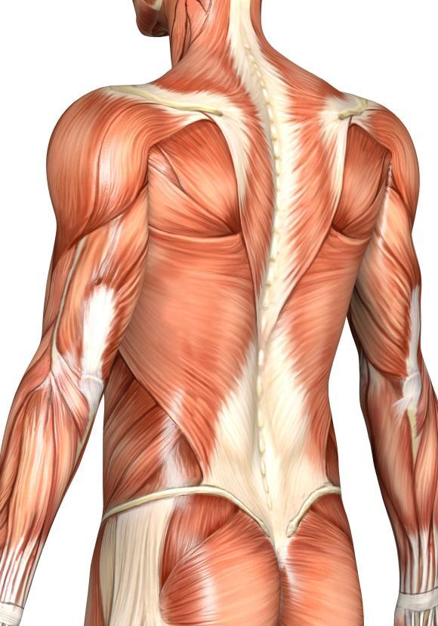
Sternocleidomastoid

Slide 3
Sternocleidomastoid
Trapezius:
Most superficial muscle of the trunk and upper body.
Diamond shaped muscle.
Extends the head, elevates and stabilizes the scapula.

Slide 4
Sternocleidomastoid
Trapezius:
Most superficial muscle of the trunk and upper body.
Diamond shaped muscle.
Extends the head, elevates and stabilizes the scapula.
Latissimus Dorsi:
Large flat muscles that cover the lower back.
Extend and adduct (bring toward midline) the humerus.
Important for power stroke or striking a blow.

Slide 5
Deltoids:
Large, fleshy upper shoulder muscles.
Favorite injection site for smaller amounts of liquid (<5mL)
Prime movers for arm abduction (moving toward lateral side)

Slide 6
Deltoids:
Large, fleshy upper shoulder muscles.
Favorite injection site for smaller amounts of liquid (<5mL)
Prime movers for arm abduction (moving toward lateral side)
Erector Spinae:
Deep muscles
3 muscle columns on each side of the vertebrae
Powerful back extendors
Provide resistance that controls bending at the waist
Commonly causes lower back pain

Slide 7
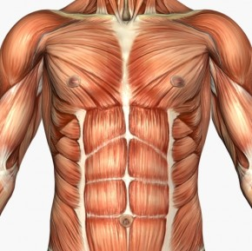
Deltoids

Slide 8
Deltoids
Pectoralis Major:
Large, fan shaped muscle
Covers upper part of chest
Acts to adduct (move toward midline) and flex (decrease angle) the arms

Slide 9
Deltoids
Pectoralis Major:
Large, fan shaped muscle
Covers upper part of chest
Acts to adduct (move toward midline) and flex (decrease angle) the arms
Intercostal muscles:
Between ribs
Deep muscle
Helps to move air in and out of the lungs
Raise ribs when inhaling, lower ribs when exhaling

Slide 10
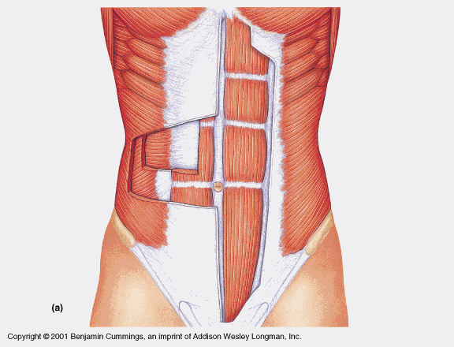
1) External Obliques:
Most superficial
Helps pull chest downward, flex and rotate the trunk, and compresses the abdomen

Slide 11
1) External Obliques:
Most superficial
Helps pull chest downward, flex and rotate the trunk, and compresses the abdomen
2) Rectus Abdominus:
Deep to external obliques, superficial to transverse abdominus
Straight muscle
Flexes vertebral column

Slide 12
1) External Obliques:
Most superficial
Helps pull chest downward, flex and rotate the trunk, and compresses the abdomen
2) Rectus Abdominus:
Deep to external obliques, superficial to transverse abdominus
Straight muscle
Flexes vertebral column
3) Internal Obliques:
Deep to external obliques
Runs at right angle to external obliques from middle downward laterally
Helps move spine

Slide 13
1) External Obliques:
Most superficial
Helps pull chest downward, flex and rotate the trunk, and compresses the abdomen
2) Rectus Abdominus:
Deep to external obliques, superficial to transverse abdominus
Straight muscle
Flexes vertebral column
3) Internal Obliques:
Deep to external obliques
Runs at right angle to external obliques from middle downward laterally
Helps move spine
4) Transverse Abdominus:
Deepest abdominal muscle
Runs horizontally
Compresses the abdomen

Slide 14
1) External Obliques:
Most superficial
Helps pull chest downward, flex and rotate the trunk, and compresses the abdomen
2) Rectus Abdominus:
Deep to external obliques, superficial to transverse abdominus
Straight muscle
Flexes vertebral column
3) Internal Obliques:
Deep to external obliques
Runs at right angle to external obliques from middle downward laterally
Helps move spine
4) Transverse Abdominus:
Deepest abdominal muscle
Runs horizontally
Compresses the abdomen
4 sets of abdominal muscles going in 4 directions to keep guts in.

