Slide 1
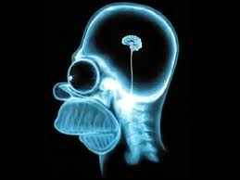
The Brain
Objective: List, identify and give functions of the major regions of the brain.

Slide 2
Human Brain
Remarkable abilities- about 3 lbs., texture of cold oatmeal

Slide 3
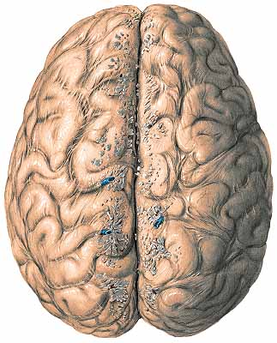
Human Brain
Remarkable abilities- about 3 lbs., texture of cold oatmeal
4 major areas:
Cerebral hemispheres

Slide 4
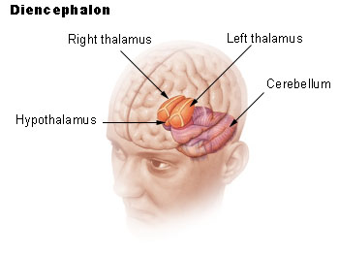
Human Brain
Remarkable abilities- about 3 lbs., texture of cold oatmeal
4 major areas:
Cerebral hemispheres
Diencephalon (inside middle of the brain)

Slide 5
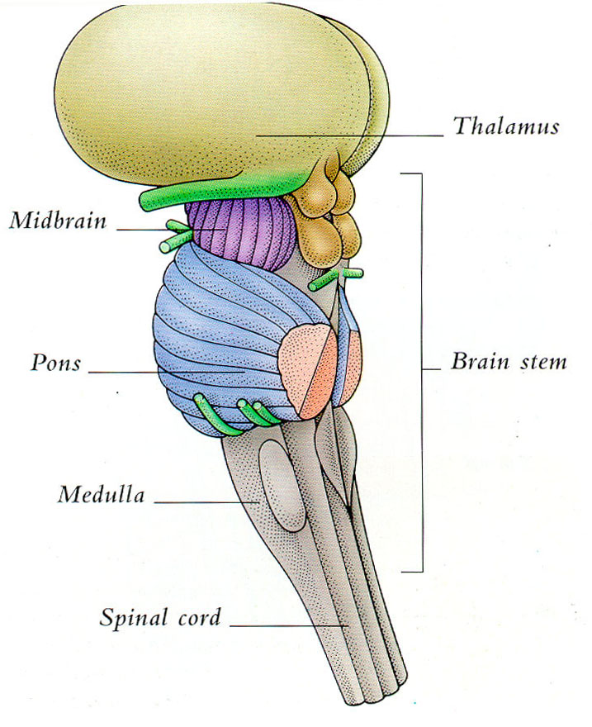
Human Brain
Remarkable abilities- about 3 lbs., texture of cold oatmeal
4 major areas:
Cerebral hemispheres
Diencephalon (inside middle of the brain)
Brain stem

Slide 6
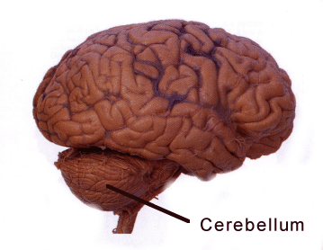
Human Brain
Remarkable abilities- about 3 lbs., texture of cold oatmeal
4 major areas:
Cerebral hemispheres
Diencephalon (inside middle of the brain)
Brain stem
Cerebellum

Slide 7
Let’s Review

Slide 8
Surface has ridges and folds
Ridges = gyri (plural of gyrus) = twisters
Grooves = sulci (plural of sulcus) = furrows (plowing term)

Slide 9
Lateral View: Cerebral Hemispheres
2 paired sides of the brain (right and left)

Slide 10
Lateral View: Cerebral Hemispheres
2 paired sides of the brain (right and left)
Superior part of the brain

Slide 11
Lateral View: Cerebral Hemispheres
2 paired sides of the brain (right and left)
Superior part of the brain
Function: higher thought processes, conscious thought, intellectual functions.

Slide 12
4 lobes:
1. Frontal Lobe- Intellectual processes, decision-making, problem solving, voluntary control of the skeletal muscles. Translation of thought into speech, personality. Primary motor area.

Slide 13
4 lobes:
2. Parietal – Specializes in using symbols in understanding (math), verbal articulation of thought and emotion, interpretation of textures and shapes. Primary sensory area.

Slide 14
4 lobes:
3. Occipital – Organized for vision and conscious seeing (recognition)

Slide 15
4 lobes:
4. Temporal – hearing, interpretation of auditory sounds, olfaction (smelling), language, emotional behavior.

Slide 16
Human Brain- Saggital View Cross section of cerebrum

Slide 17
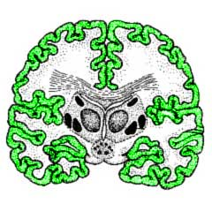
Human Brain- Saggital View Cross section of cerebrum
Cerebral cortex

Slide 18
Human Brain- Saggital View Cross section of cerebrum
Cerebral cortex
Outermost layer (2-4mm)

Slide 19
Human Brain- Saggital View Cross section of cerebrum
Cerebral cortex
Outermost layer (2-4mm)
Consists of grey matter

Slide 20
Human Brain- Saggital View Cross section of cerebrum
Cerebral cortex
Outermost layer (2-4mm)
Consists of grey matter
Contains cell bodies of neurons (not myelinated)

Slide 21
Human Brain- Saggital View Cross section of cerebrum
Cerebral cortex
Outermost layer (2-4mm)
Consists of grey matter
Contains cell bodies of neurons (not myelinated)
Highly convoluted (goes in and out) with fissures (deep infoldings) and sulci (less deep infoldings) – increases surface area

Slide 22
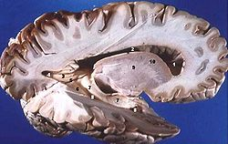
White Matter:

Slide 23
White Matter:
Inner area, deep to grey matter

Slide 24
White Matter:
Inner area, deep to grey matter
Contains bundles of nerve fibers that carry nerve impulses in and out of the cortex

Slide 25
Corpus Callosum:

Slide 26
Corpus Callosum:
Very large fiber tract that allows communication between the right and left hemispheres of the cerebrum

Slide 27
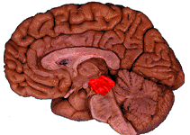
Midbrain:
Part of the brain stem

Slide 28
Midbrain:
Part of the brain stem
Contains corpora quadrigemina (sensory nuclei)

Slide 29
Midbrain:
Part of the brain stem
Contains corpora quadrigemina (sensory nuclei)
Reflex centers involved with vision and hearing

Slide 30
Diencephalon:
Interbrain

Slide 31
Diencephalon:
Interbrain
Sits on top of the brain stem

Slide 32
Diencephalon:
Interbrain
Sits on top of the brain stem
Enclosed by the cerebral hemispheres

Slide 33
Diencephalon:
Contains:
Thalamus, a relay station for sensory information (filters sensory information coming in)

Slide 34
Diencephalon:
Contains:
Thalamus, a relay station for sensory information (filters sensory information coming in)
Hypothalamus, puts out a lot of hormones. Contains centers for rage, pleasure, pain, sex. Regulates water balance, body temperature, and metabolism. Regulates pituitary gland (growth hormones, oxytocin, antidiuretic hormone), thyroid stimulating hormones

Slide 35
Diencephalon:
Contains:
Thalamus, a relay station for sensory information (filters sensory information coming in)
Hypothalamus, puts out a lot of hormones. Contains centers for rage, pleasure, pain, sex. Regulates water balance, body temperature, and metabolism. Regulates pituitary gland (growth hormones, oxytocin, antidiuretic hormone), thyroid stimulating hormones
Epithalamus, contains pineal body, which affects body by secreting melatonin

Slide 36
Diencephalon:
Contains:
Thalamus, a relay station for sensory information (filters sensory information coming in)
Hypothalamus, puts out a lot of hormones. Contains centers for rage, pleasure, pain, sex. Regulates water balance, body temperature, and metabolism. Regulates pituitary gland (growth hormones, oxytocin, antidiuretic hormone), thyroid stimulating hormones
Epithalamus, contains pineal body, which affects body by secreting melatonin
Pituitary gland- secretes hormones

Slide 37
Brainstem: (about the size of your thumb)
Midbrain- small, superior part of the brain stem. Contains the centers for visual reflexes

Slide 38
Brainstem: (about the size of your thumb)
Midbrain- small, superior part of the brain stem. Contains the centers for visual reflexes
Pons- means bridge, between medulla and midbrain. Important in the control of breathing

Slide 39
Brainstem: (about the size of your thumb)
Midbrain- small, superior part of the brain stem. Contains the centers for visual reflexes
Pons- means bridge, between medulla and midbrain. Important in the control of breathing
Medulla oblongata- inferior part of the brain stem. Important fiber tract area (group of nerves), especially sensory and motor pathways. Connects brain to the spinal cord. Center that regulates heart rate, respiratory rate, blood pressure, swallowing, vomiting, sneezing, and coughing.

Slide 40
Brainstem: (about the size of your thumb)
Midbrain- small, superior part of the brain stem. Contains the centers for visual reflexes
Pons- means bridge, between medulla and midbrain. Important in the control of breathing
Medulla oblongata- inferior part of the brain stem. Important fiber tract area (group of nerves), especially sensory and motor pathways. Connects brain to the spinal cord. Center that regulates heart rate, respiratory rate, blood pressure, swallowing, vomiting, sneezing, and coughing.
Cerebellum- large projection dorsally of occipital lobe. Outer cortex composed of grey matter (cell bodies), and inner cortex of white matter (axons leaving sensory part). Responsible for balance and equilibrium. Rapid adjustments for body tone and body adjustments.

Slide 41
Protection of the CNS
Meninges

Slide 42
Protection of the CNS
Meninges
Dura Mater: (hard mother)
2 layers of connective tissue
One is attached to the periosteum of the bone
One is the outermost covering of the brain and spinal cord
Folds inward and forms sinuses for venous blood

Slide 43
Protection of the CNS
Meninges
Dura Mater: (hard mother)
2 layers of connective tissue
One is attached to the periosteum of the bone
One is the outermost covering of the brain and spinal cord
Folds inward and forms sinuses for venous blood
Arachnoid Mater: (spider mother)
Threadlike connective tissue that attaches to the innermost layers

Slide 44
Protection of the CNS
Meninges
Dura Mater: (hard mother)
2 layers of connective tissue
One is attached to the periosteum of the bone
One is the outermost covering of the brain and spinal cord
Folds inward and forms sinuses for venous blood
Arachnoid Mater: (spider mother)
Threadlike connective tissue that attaches to the innermost layers
Pia Mater: (gentle, delicate mother)
Thin layer of connective tissue that clings to the brain and spinal cord

Slide 45
Protection of the CNS

Slide 46
Protection of the CNS
Cerebrospinal fluid- fluid in brain
Watery cushion that protects the nervous tissue from blow and trauma.

Slide 47
Protection of the CNS
Blood Brain Barrier

Slide 48
Protection of the CNS
Blood Brain Barrier- membranes that separate the brain and blood. Keeps out bacteria, toxins, proteins and hydrophilic molecules, while allowing the diffusion of O2 and CO2, hormones, anesthesia, and active transport of glucose.

Slide 49
Diseases
Meningitis- infection of the meninges. Can be bacterial or viral. May spread to the CNS.
Can cause disruption of the brain-blood barrier, allowing bacteria and toxins to enter the CNS.

