Slide 1
Connective Tissue

Slide 2
Connective Tissue
General Characteristics
General Functions
Does have blood vessels-
variations in blood supply (ligaments and tendons don’t heal as fast because they are poorly vascularized)
Cartilage is avascular –no blood supply- heals very slowly

Slide 3
Connective Tissue
General Characteristics
General Functions
Does have blood vessels-
variations in blood supply (ligaments and tendons don’t heal as fast because they are poorly vascularized)
Cartilage is avascular –no blood supply- heals very slowly
2. Has extracellular matrix- a non-living substance outside the cells (surrounds cells), secreted by the connective tissue cells

Slide 4
Connective Tissue
General Characteristics
General Functions
Does have blood vessels-
variations in blood supply (ligaments and tendons don’t heal as fast because they are poorly vascularized)
Cartilage is avascular –no blood supply- heals very slowly
2. Has extracellular matrix- a non-living substance outside the cells (surrounds cells), secreted by the connective tissue cells
Soft cushioning and packing around organs (ex. Adipose tissue)

Slide 5
Connective Tissue
General Characteristics
General Functions
Does have blood vessels-
variations in blood supply (ligaments and tendons don’t heal as fast because they are poorly vascularized)
Cartilage is avascular –no blood supply- heals very slowly
2. Has extracellular matrix- a non-living substance outside the cells (surrounds cells), secreted by the connective tissue cells
Soft cushioning and packing around organs (ex. Adipose tissue)
Can bear weight (bones)

Slide 6
Connective Tissue
General Characteristics
General Functions
Does have blood vessels-
variations in blood supply (ligaments and tendons don’t heal as fast because they are poorly vascularized)
Cartilage is avascular –no blood supply- heals very slowly
2. Has extracellular matrix- a non-living substance outside the cells (surrounds cells), secreted by the connective tissue cells
Soft cushioning and packing around organs (ex. Adipose tissue)
Can bear weight (bones)
Can withstand stretching and abrasion

Slide 7
Connective Tissue
General Characteristics
General Functions
Does have blood vessels-
variations in blood supply (ligaments and tendons don’t heal as fast because they are poorly vascularized)
Cartilage is avascular –no blood supply- heals very slowly
2. Has extracellular matrix- a non-living substance outside the cells (surrounds cells), secreted by the connective tissue cells
Soft cushioning and packing around organs (ex. Adipose tissue)
Can bear weight (bones)
Can withstand stretching and abrasion
Can bind together other body tissues

Slide 8
Connective Tissue
General Characteristics
General Functions
Does have blood vessels-
variations in blood supply (ligaments and tendons don’t heal as fast because they are poorly vascularized)
Cartilage is avascular –no blood supply- heals very slowly
2. Has extracellular matrix- a non-living substance outside the cells (surrounds cells), secreted by the connective tissue cells
Soft cushioning and packing around organs (ex. Adipose tissue)
Can bear weight (bones)
Can withstand stretching and abrasion
Can bind together other body tissues
Can absorb large amounts of water and serve as a reservoir (fibrocartilage between vertebrae)

Slide 9
Classification

Slide 10
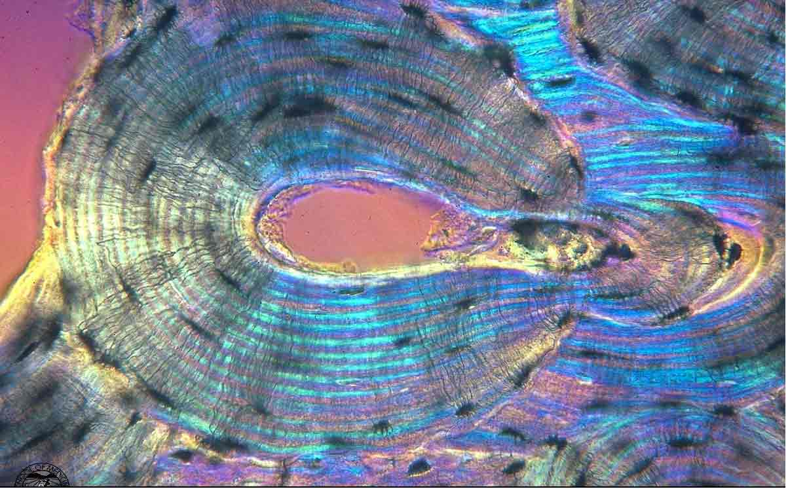
Bone
Description
Examples
Osseous tissue
Bone cells are small caves called lacunae surrounded by hard matrix of calcium phosphate
Protects organs
Skull, protects the brain

Slide 11
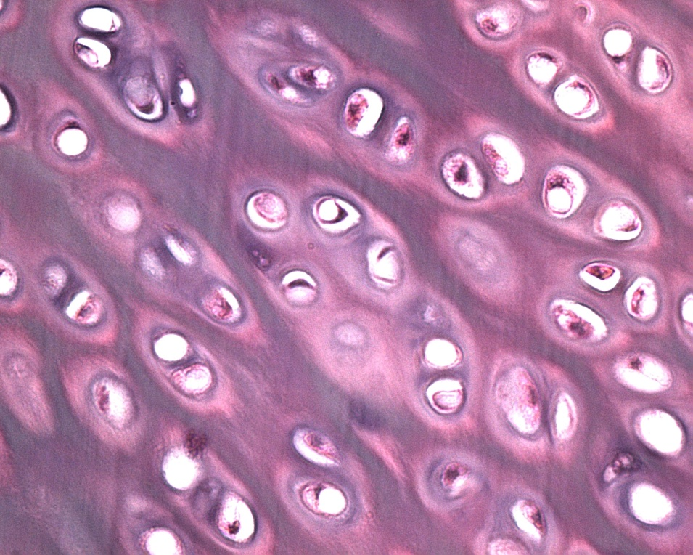
Cartilage
Description
Examples
Less hard and more flexible
Hyaline cartilage – glassy and smooth, found at the ends of bones
Fibrocartilage – cushions bones, intervertebral disks
Elastic cartilage – stretchy, in ears

Slide 12
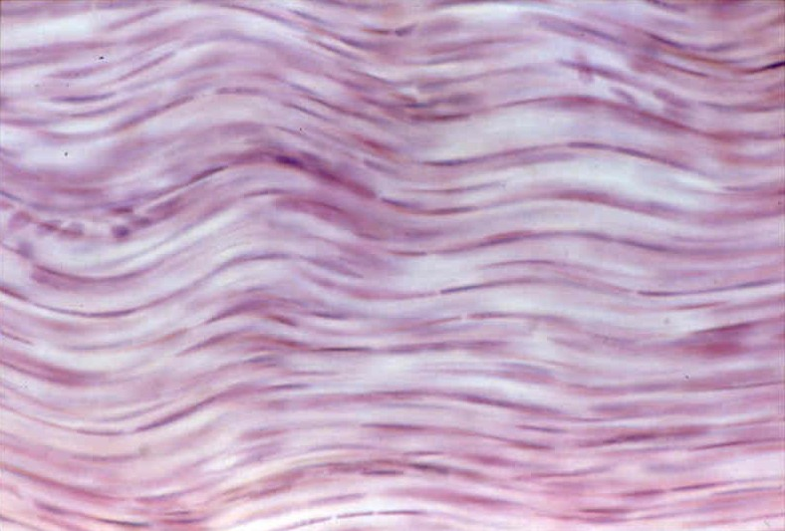
Dense Connective Tissue
Description
Examples
Collagen fibers in a dense matrix
Cells, called fibroblasts, are more crowded
Ligaments and tendons

Slide 13
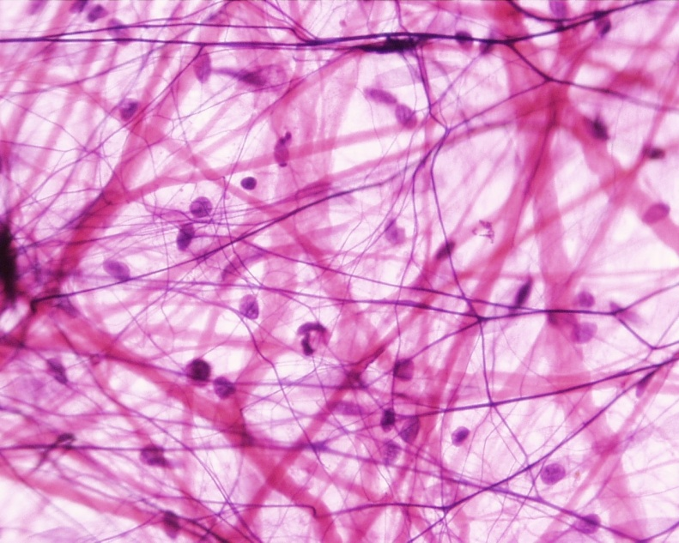
Loose Connective Tissue
Description
Examples
Softer and fewer cells, more matrix
Cobwebby covering over muscles – Areolar
Fat – Adipose tissue

Slide 14
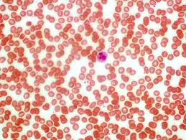
Blood
Description
Examples
Cells within a liquid matrix called plasma
Blood

