Slide 1
Muscles of the Head & Neck

Slide 2
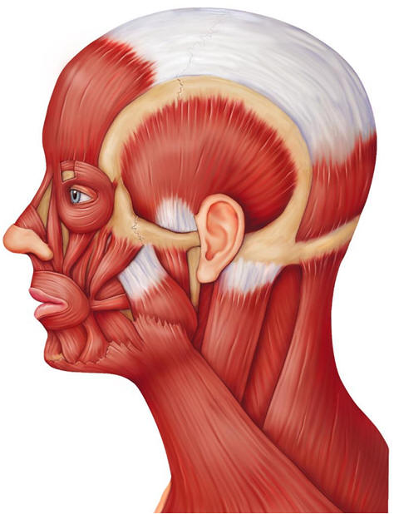
Frontalis: covers the frontal bone-raises the eyebrows and wrinkles the forehead

Slide 3
Frontalis: covers the frontal bone-raises the eyebrows and wrinkles the forehead

Slide 4
Frontalis: covers the frontal bone-raises the eyebrows and wrinkles the forehead
Temporalis: covers the temporal bone.
Big, fan-shaped muscle.
Also helps to raise the mandible.

Slide 5
Frontalis: covers the frontal bone-raises the eyebrows and wrinkles the forehead
Temporalis: covers the temporal bone.
Big, fan-shaped muscle.
Also helps to raise the mandible.
Obicularis oculi: runs in circles around the eye. Can close eyes, squint, blink, wink.

Slide 6
Frontalis: covers the frontal bone-raises the eyebrows and wrinkles the forehead
Temporalis: covers the temporal bone.
Big, fan-shaped muscle.
Also helps to raise the mandible.
Obicularis oculi: runs in circles around the eye. Can close eyes, squint, blink, wink.
Trapezius:
(part of back muscles)

Slide 7
Obicularis Oris: circular muscle around the lips. Protrudes lips. “kissing muscle”

Slide 8
Obicularis Oris: circular muscle around the lips. Protrudes lips. “kissing muscle”
Buccinator: goes horizontally across the cheek-used for whistling, playing the trumpet, holds food when you chew.

Slide 9
Obicularis Oris: circular muscle around the lips. Protrudes lips. “kissing muscle”
Buccinator: goes horizontally across the cheek-used for whistling, playing the trumpet, holds food when you chew.
Platysma: flat muscle that pulls mouth downward

Slide 10
Obicularis Oris: circular muscle around the lips. Protrudes lips. “kissing muscle”
Masseter: chewing muscle (for mastication) Raises mandible to close the jaw
Buccinator: goes horizontally across the cheek-used for whistling, playing the trumpet, holds food when you chew.
Platysma: flat muscle that pulls mouth downward

Slide 11
Obicularis Oris: circular muscle around the lips. Protrudes lips. “kissing muscle”
Zygomaticus: goes from the corner of mouth to cheek bone. Raises mouth edges- smile.
Masseter: chewing muscle (for mastication) Raises mandible to close the jaw
Buccinator: goes horizontally across the cheek-used for whistling, playing the trumpet, holds food when you chew.
Platysma: flat muscle that pulls mouth downward

Slide 12
Sternocleidomastoids: pair of muscles flex to bow head
Obicularis Oris: circular muscle around the lips. Protrudes lips. “kissing muscle”
Zygomaticus: goes from the corner of mouth to cheek bone. Raises mouth edges- smile.
Masseter: chewing muscle (for mastication) Raises mandible to close the jaw
Buccinator: goes horizontally across the cheek-used for whistling, playing the trumpet, holds food when you chew.
Platysma: flat muscle that pulls mouth downward

